Slide 1
turbine_trends
File created on: 2/23/2023 12:57:44 PM

Slide 2
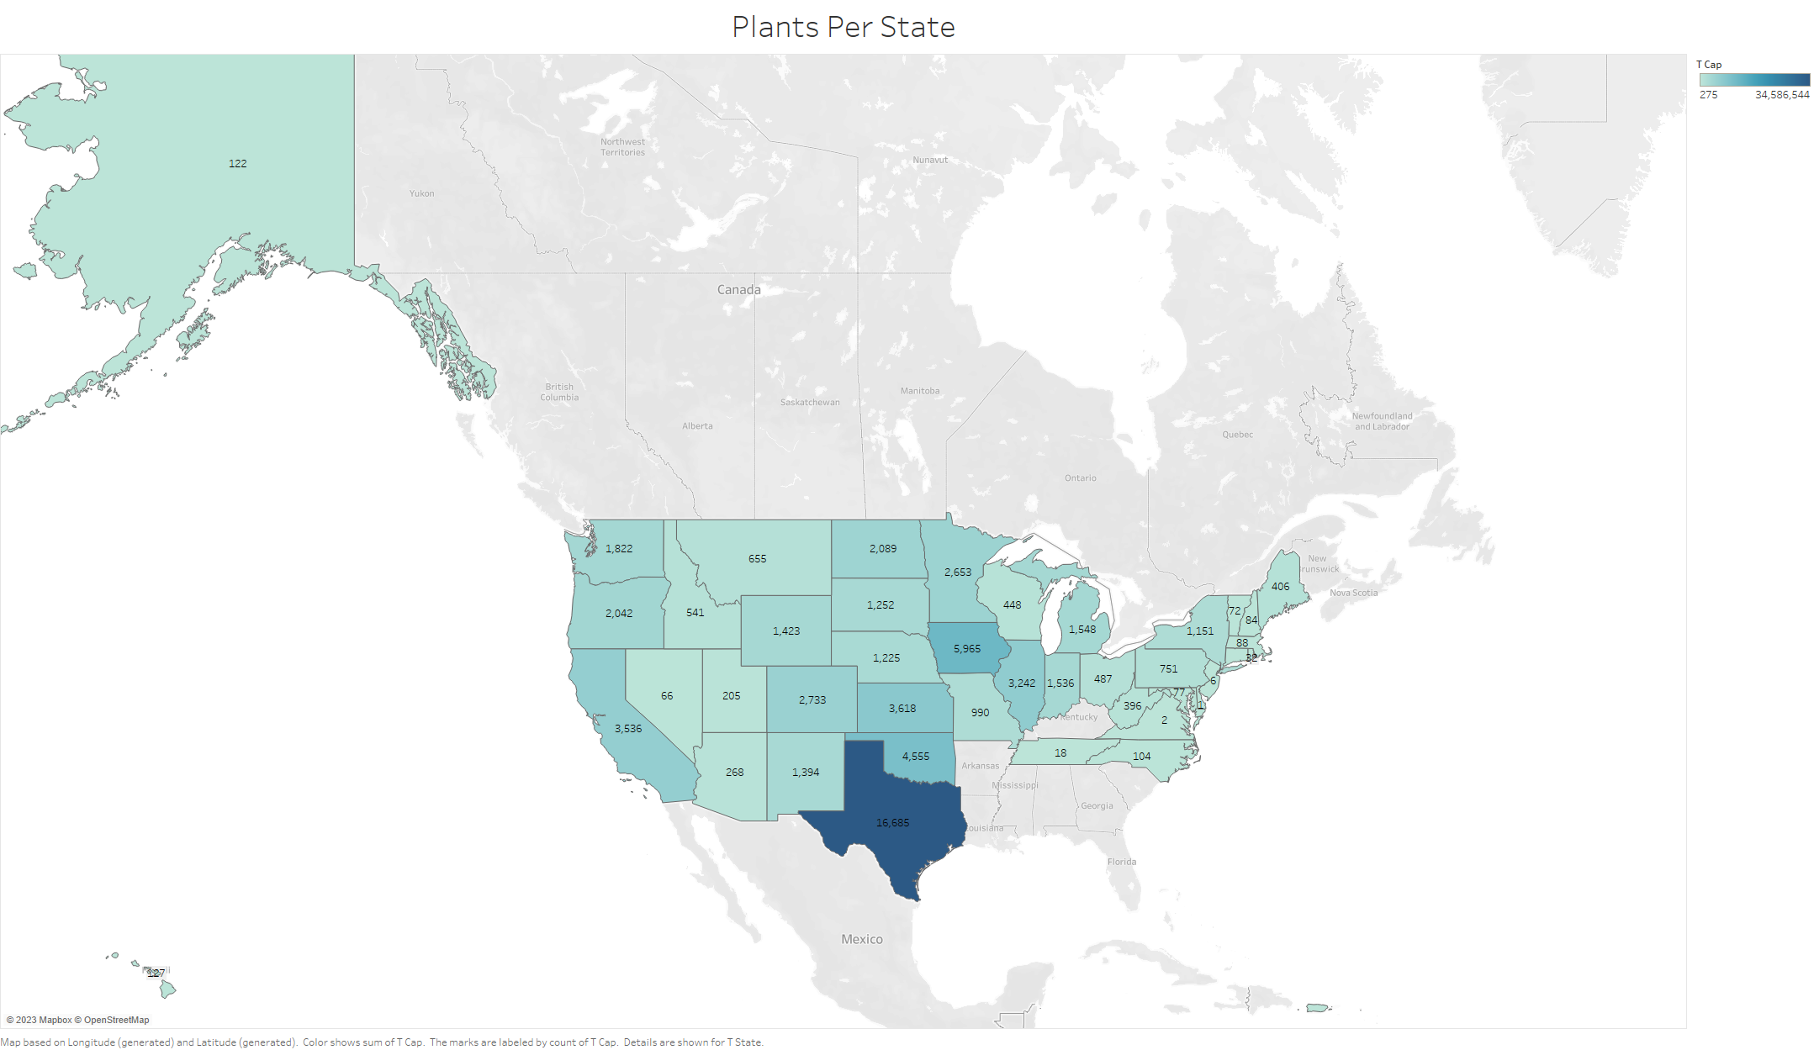

Slide 3
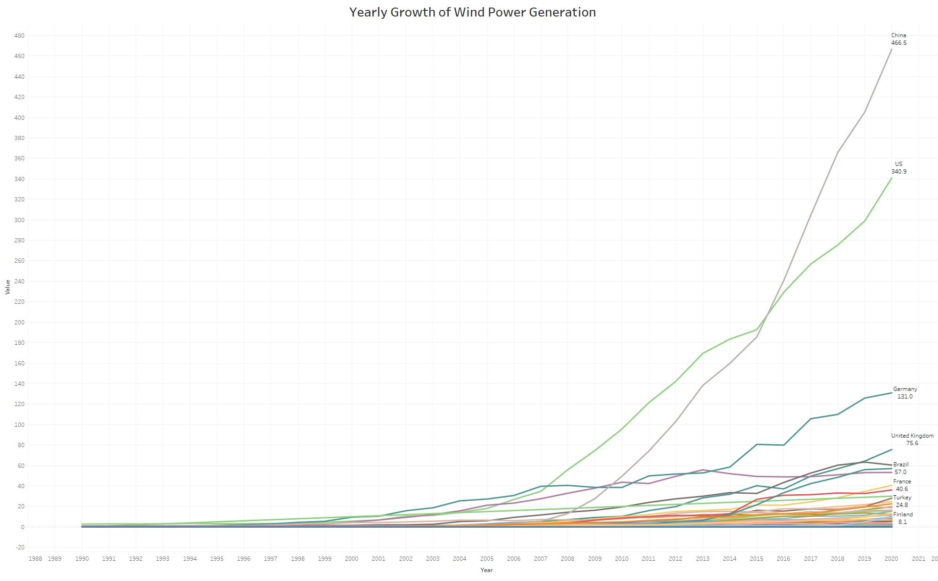

Slide 4
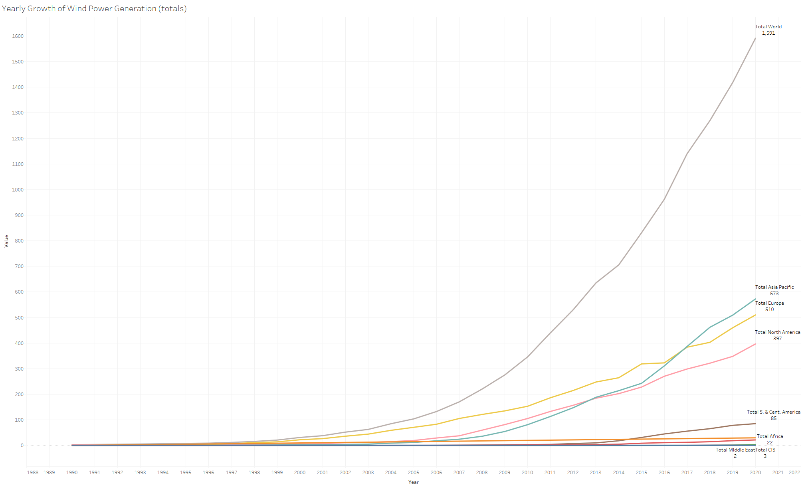

Slide 5
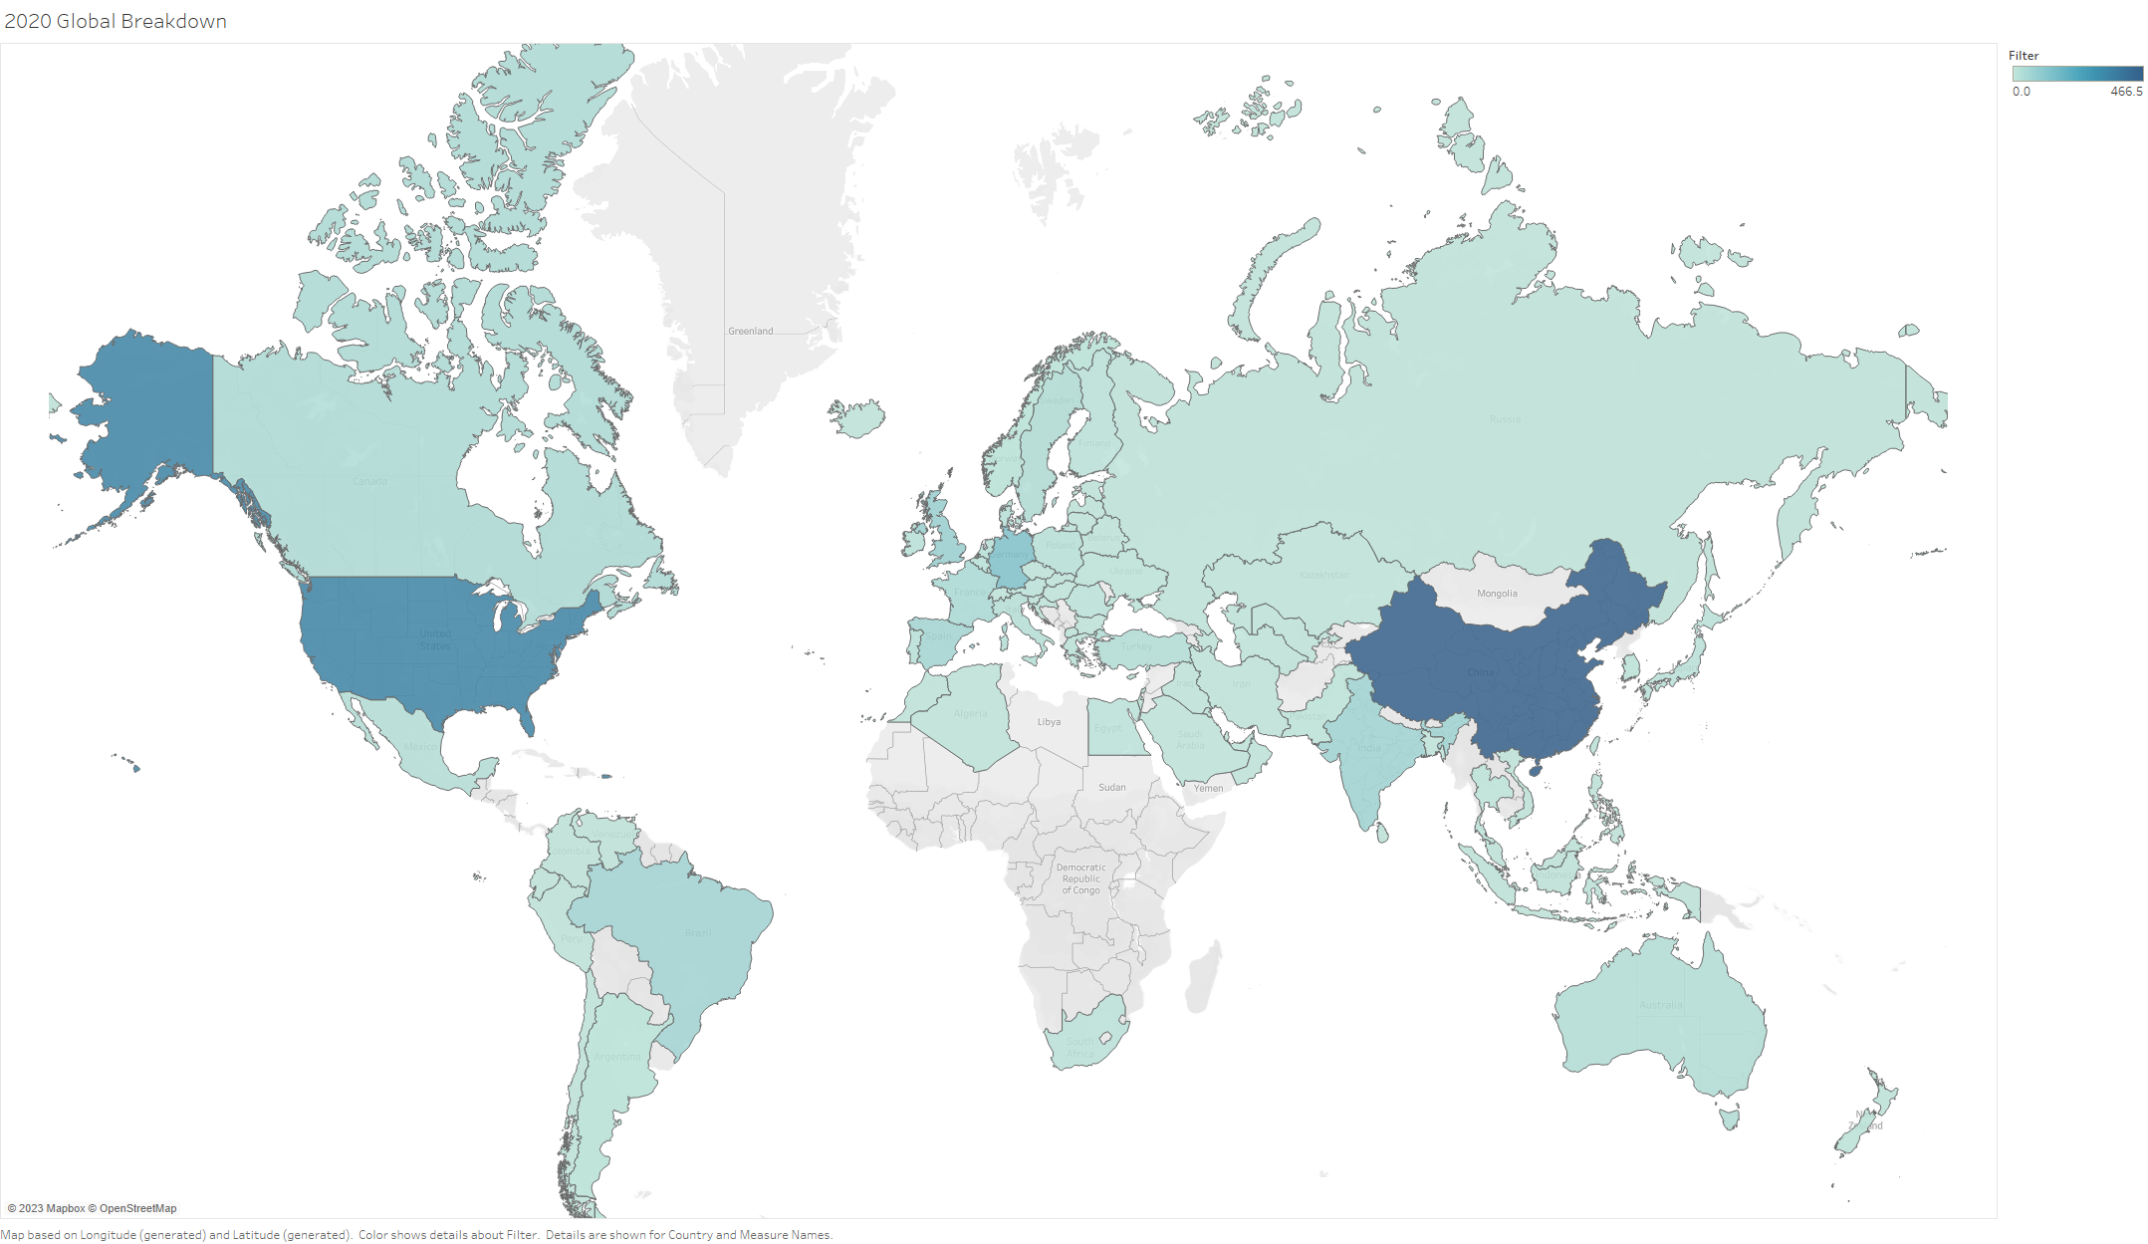

Slide 6
